Slide 1


Slide 2
Supporting Students with Disabilities in Making the Transition to College
Pascuala Herrera, M.Ed. Professor, Learning Specialist
Debbie Franzen, M.Ed. Accommodation and Transition Specialist

Slide 3
Desired Outcomes
Participants will gain knowledge about:
  College Awareness Program (CAP)
  Summer Orientation for Students with Disabilities.
  Academic Coaches Empowering Students (ACES)
Participants will learn practical strategies to:
  Help students with disabilities transition to college
  Gain ideas on how to assist at risk students in their transition to college

Slide 4
Presentation Agenda
  Introduction
  Brief overview of Harper College
  Overview of the Harper’s CAP program
  Overview of Harper’s Summer Orientation Program
  Overview of ACES Program
  Outcome Results
  Benefits of Specialized Transition Programs
  Challenges of Specialized Transition Programs

Slide 5
Introduction
Pascuala Herrera – M.Ed., Professor and Learning Specialist at Harper for 23 years. Work primarily with students with LD/ADHD. Teach FYE101 and Humanistic Psychology.
Debbie Franzen – M.Ed., Accommodation & Transition Specialist at Harper College for 17 years. Work primarily with students with small incidence disabilities and facilitate transitioning of high school students with disabilities into college.
Audience

Slide 6
Harper College
  Located in Palatine, IL - NW suburb of Chicago
  Community college serving 26,000 students
  Access and Disability Services serves 1400 students
  LD/ADHD students is the largest population in ADS(over 700) in 2014
    Students on the Autism Spectrum have grown over 300% in the last five years. In 2008, we served 17 students and now over 80 students.
    We provide comprehensive services such as advising, transfer/career advising, personal counseling, accommodations, instructional support and academic coaching
  Harper’s strategic goals focus on student success and student completion

Slide 7
CAP (College Awareness Program)
  Transition Program for high school students with disabilities
  Area high schools are invited to bring students to visit campus, attend presentation and tour campus
  Learn about campus resources, accommodations and services, career and degree programs, college expectations

Slide 8
Benefits of Attending CAP
Students connect with the ADS office and staff early
Students have opportunity to complete New Student Orientation in ADS
Students have opportunity to learn about specialized programs and services

Slide 9
Summer Orientation for Students with Disabilities
  Work in Collaboration with the Center for New Students and Orientation (CNSO)
  Students with disabilities have the option of completing their orientation through ADS or CNSO
  ADS Orientation
    Includes Intake, ADS Workshop, Advising and Accommodation Planning
    All components are individualized except the Workshops
    Students who attend general orientation are referred to us for intake and accommodations
    Provides an opportunity to develop relationships with students

Slide 10
ACES (Academic Coaches Empowering Students)
  History – from PASS to ACES
  Focuses on providing support to students during their first year of college
  Students enroll in FYE 101 course
  Instructor of FYE 101 course becomes the students’ academic coach
  Program supports up to 80 incoming new students.
  Curriculum includes three required meetings outside of class
  Students in ACES are automatically enrolled in Harper College’s Early Alert Program

Slide 11
FYE 101 (First Year Experience)
  2 credit course
  Offered in first 8 weeks of the semester or first 2 weekends
  One credit focuses on transition issues, one credit on advocacy
  Targeted sections offered for students with disabilities
  Weekend section specifically for students on the Autism Spectrum
  Curriculum is designed to address specific needs of students with disabilities

Slide 12
FYE Topics covered
  Disability Awareness and Self Advocacy
  Executive Functioning
  Utilization of Campus Resources
  Skills Needed to be Successful
  Appropriate College behavior
  Personal Growth/Stress Management
  Goals Setting

Slide 13
Assessment Results

Slide 14
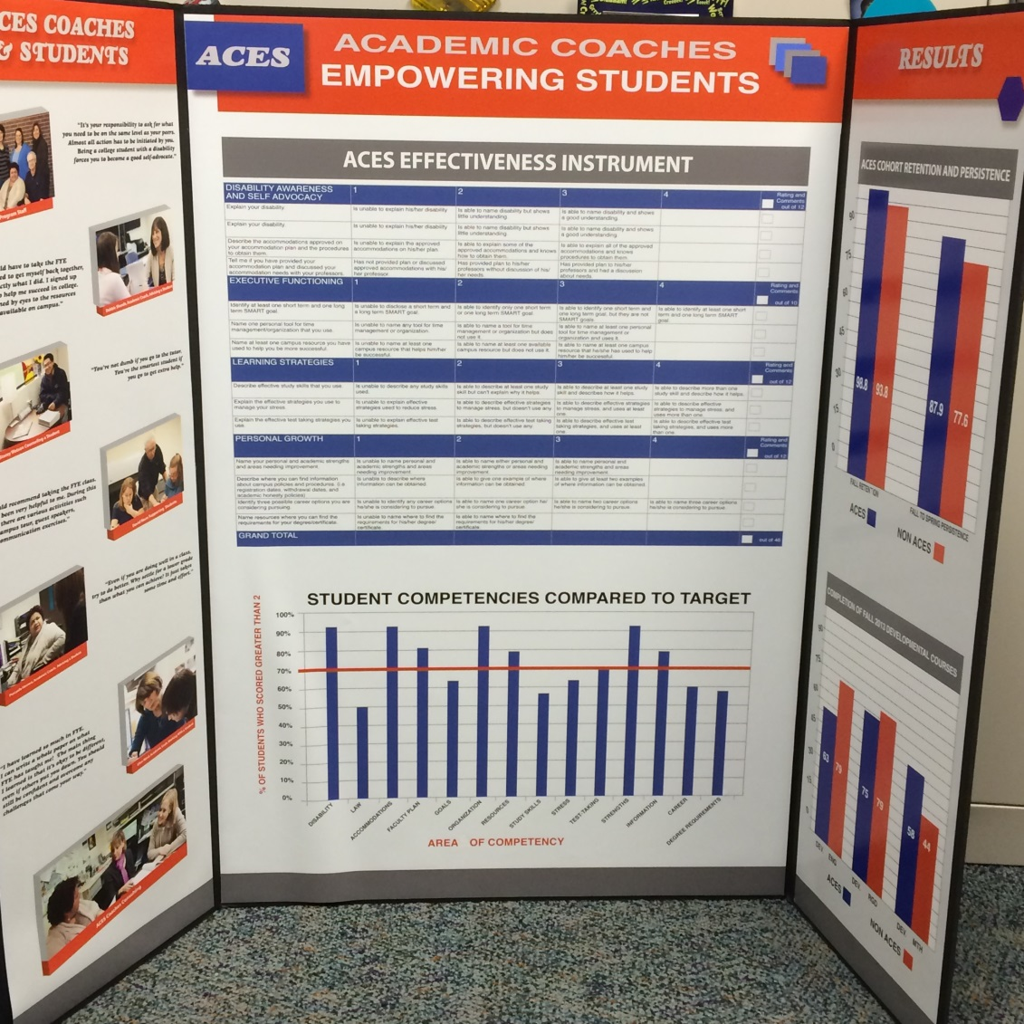
Poster Presentation

Slide 15
Assessment Results

Slide 16
Classroom Activities that Incorporate Strategies
Assign campus resources to groups and put them on a scavenger hunt to research each service offered at Harper.
Have student panel from past years give tips on how to be successful.
Have many guest speakers from across campus such, Harper Police, Financial Aid, Career Center, and Library.
Have students write a letter to a next year student giving them tips for success.

Slide 17
Classroom Activities that Incorporate Strategies continued
Have each student write and practice a script on how to communicate about their disability to their professors.
Present case studies about past student behaviors that ended up in student conduct.
Give hands on training on how to use their student portal and Harper website.
All activities require social interaction in small groups or with a partner which is varied through the course.

Slide 18
Benefit of Specialized Transition Program
Students are made aware of how different their role will be in college in acquiring accommodations
Students disability is taken into account when planning their first semester courses
Parents and students’ anxiety is reduced knowing that the students needs will be met
They will begin the semester with their accommodations in place
Students continue to be supported

Slide 19
Challenges of a Specialized Transition Program
Establishing working relationships with other areas of the college.
Aligning with the goals of general orientation
Challenging to cover all general information and ADS information within a few visits
Funding the more individualized supportive approach
Determining the best Schedule

Slide 20
Wrap Up
Questions
Contact Information:
  Pascuala Herrera - pherrera@harper college.edu
  Debbie Franzen - dfranzen@harpercollege.edu

